Slide 1
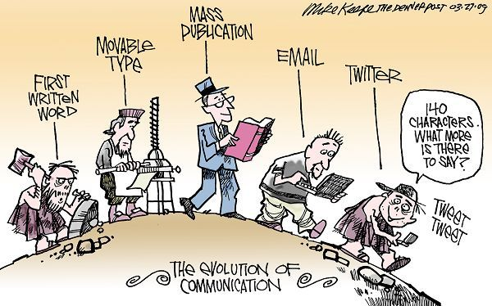
CMN 1160A – Introduction to Media Studies
Week 2A: Defining the Field
Daniel J. Paré
University of Ottawa, Department of Communication
September 13, 2016
Notes:
1

Slide 2
Teaching Assistants
Martine Stevens
Office Hours: Weds 2 - 4pm
Location: DMS 11130
Éric Dicaire
Office Hours: Fri 11am-noon
Location: DMS 11130
Email: cmn1160b.ta@gmail.com

Slide 3


Slide 4


Slide 5
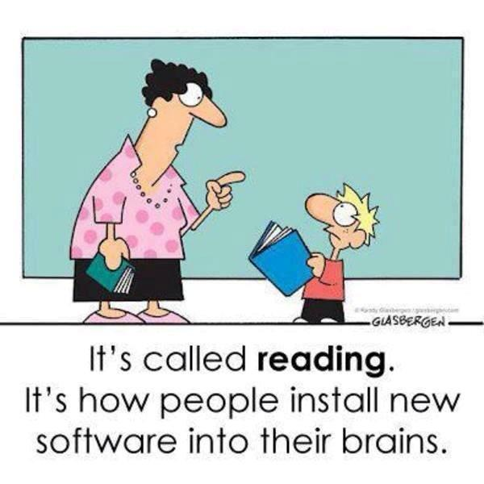

Slide 6
Course Assessment
Exam # 1 ~ 80 minutes (Chapters 1-4 inclusive) | 25% of final mark | Thurs Oct. 6/16 ~ 60-80 multiple guess & true/false questions
Exam # 2 ~ 80 minutes (Chapters 5-8 inclusive) | 25% of final mark | Tues Nov. 15/16 ~ 60-80 multiple guess & true/false questions
Think Piece Essay | 15% of final mark | Tues Nov. 22/16
Final Exam ~ 180 minutes (Chapters 1-12) (Emphasis on Chapters 9-12) | 35% of final mark | Exam time (Dec. 9 – Dec. 22) ~ 150-180 multiple guess & true/false questions

Slide 7

Etiquette: Rules of the Game
Come to class prepared (i.e. complete readings before class, ready to actively engage in class discussions)
Meetings begin promptly at 16:00 on Tuesdays and 14:30 on Thursdays
Please refrain from bringing food to, and/or eating during, class meetings. Beverages are fine

Slide 8
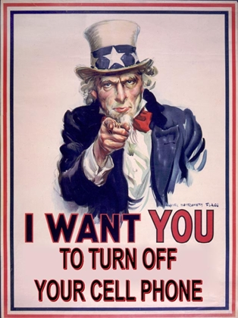
Etiquette: Rules of the Game

Slide 9

WEAPONS OF
MASS DISTRACTION

Slide 10
Steps for Success:
1. Work Hard
2. Have Fun
3. Be Kind

Slide 11
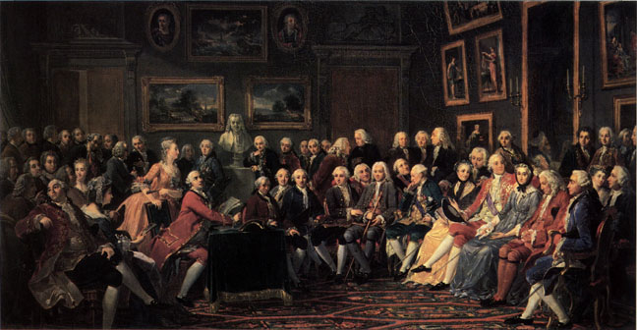
Notes:
11

Slide 12

Importance of Media
Primary agent of socialization - Pervasive
Information source
Entertainment /info-tainment
Agenda-setting
Global economy
Binding/unifying (or fragmentive?)
Notes:
12

Slide 13
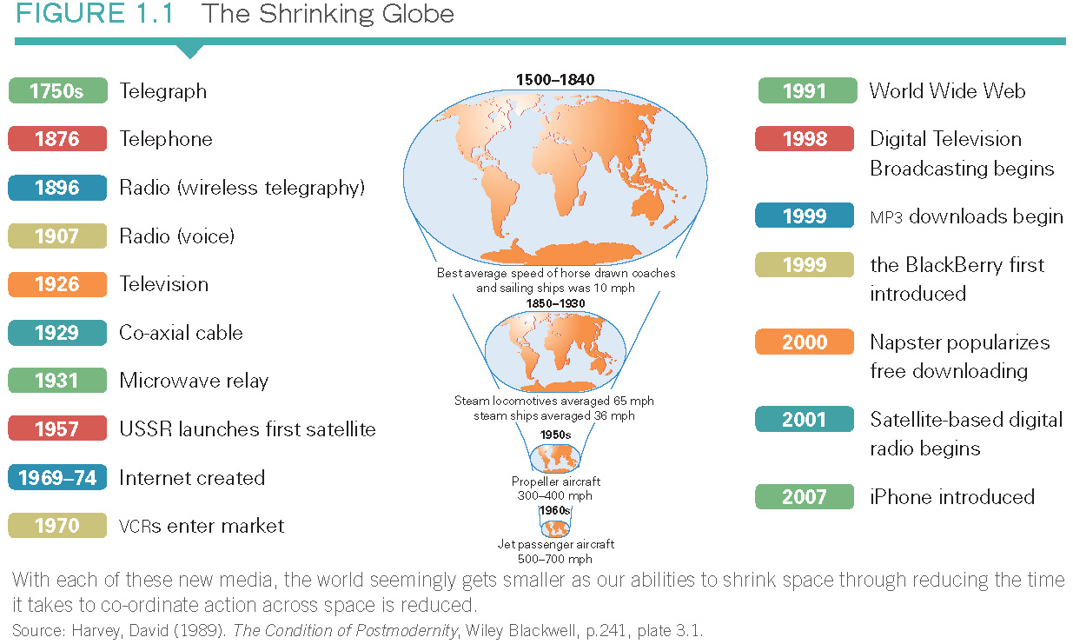
Importance of Media
Notes:
13

Slide 14

Media trends
1. Convergence
(Blurring of sectoral boundaries)
Technological – end of distinction between content and carriage
Commercial – bundling of services
Corporate – consolidation of media companies
2. Regulatory uncertainty
Control of diffusion of content?
Canadian content rules?
Liberalism vs paternalism
Notes:
14

Slide 15
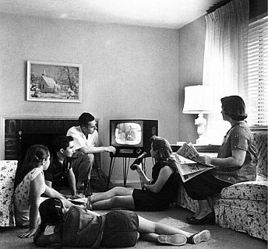
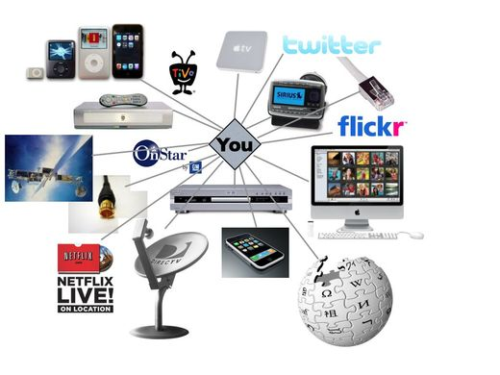
Old media versus New media
Old media
limited supply of homogenous content
Undifferentiated reception and effect
delivered to passive mass audience
Emerging Digital Media
multiple and diverse sources
multiple and diverse content
varied and unpredictable reception and effect
delivered fragmented audience
Notes:
15

Slide 16

Models of Communication
Notes:
16

Slide 17
 | Process or Transmission School | Semiotic School
Definition of Communication | transmission of messages | production and exchange of meanings
Object of Study | how senders and receivers encode and decode messages how transmitters use channels and media of communication how and why communication breaks down | how messages or texts interact with people in order to produce meanings connection between the meanings people make and the culture(s) in which they live
Main Concern | efficiency and accuracy of communication | role of texts in culture
View of Communication | form of social interaction process by which one person affects the behavior or state of another | form of social interaction communicative social interaction as constituting the individual as a member of a particular culture or society
Definition of a Message | that which is transmitted in the communication process intention or intended meaning as crucial factor | as a construction of signs which, through interaction with receivers, produces meanings, including: conscious and unconscious meanings; cultural assumptions and values
View of Mis-understanding | communication failure (looks to stages in process of communication to determine where failure occurred) | may be the result of things like cultural differences between senders and receivers; not necessarily communication failure
Emphasis | process of communication and on correcting errors or failures in communication process on “reading” and how “readers” with different social experiences or from different cultures may find different meanings in the same text | on “reading” and how readers with different social experiences or from different cultures may find different meanings in the same text
Source: Fiske, John (1990). Introduction to Communication Studies. New York: Routledge

Slide 18
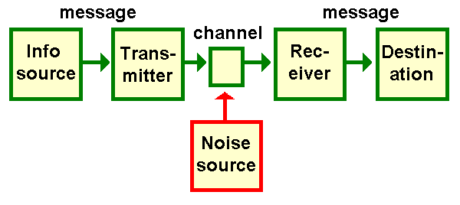
Shannon and Weaver Model

Slide 19
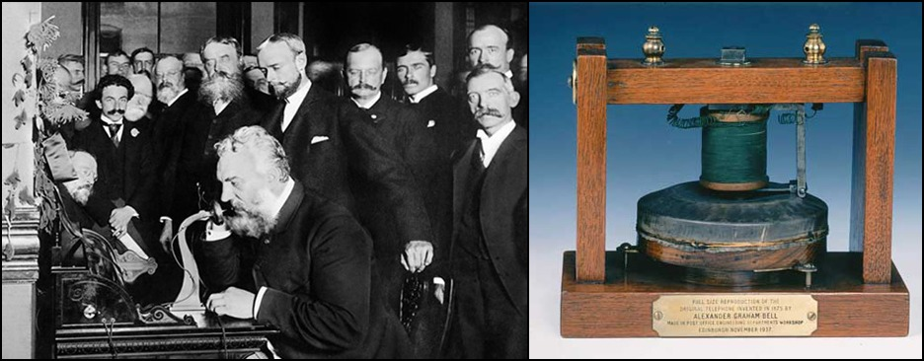
Shannon and Weaver Model

Slide 20
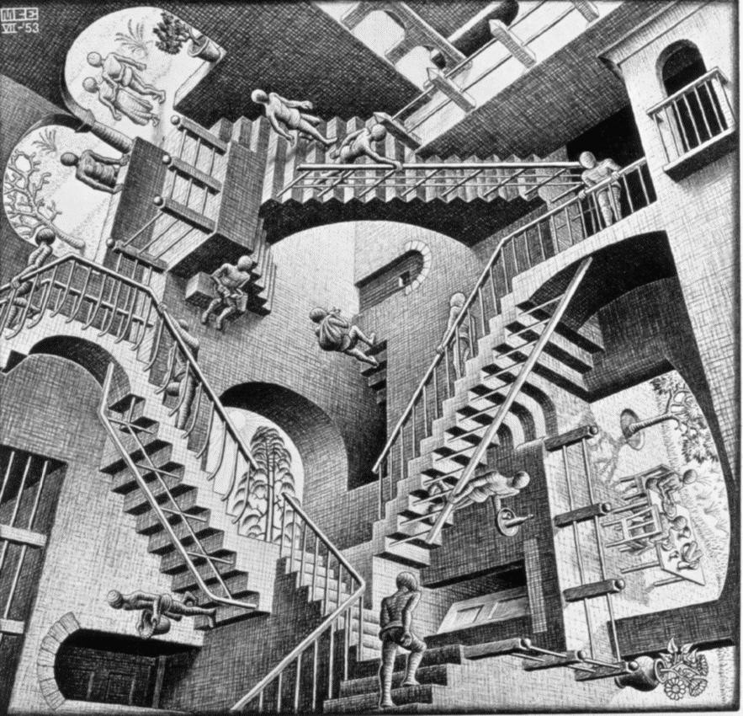
Escher - Relativity (1953)

Slide 21
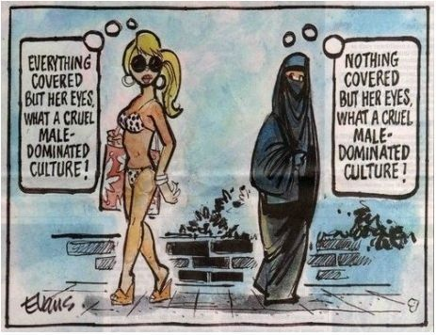
Semiotic School

Slide 22
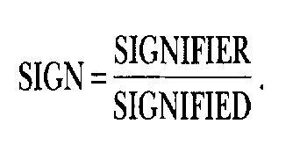
What is a sign?
Conceptual dimension
Physical dimension
Representational dimension

Slide 23
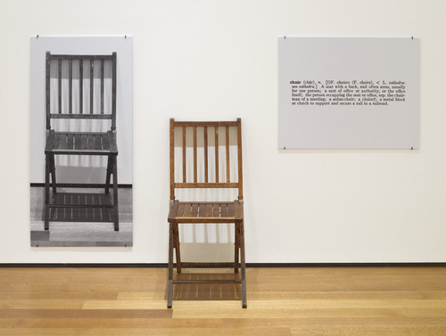
Which is the ‘real’ chair?
Joseph Kosuth, "One and Three Chairs," 1965.

Slide 24

Barthes’ Two Orders of Signification
Two levels of meaning:
Denotation
That which is inscribed, literally
Everyday meaning of a sign
2. Connotation
Reading a sign in terms of cultural ideology
Sign meets and interacts with ideas, values, beliefs and emotions of users

Slide 25
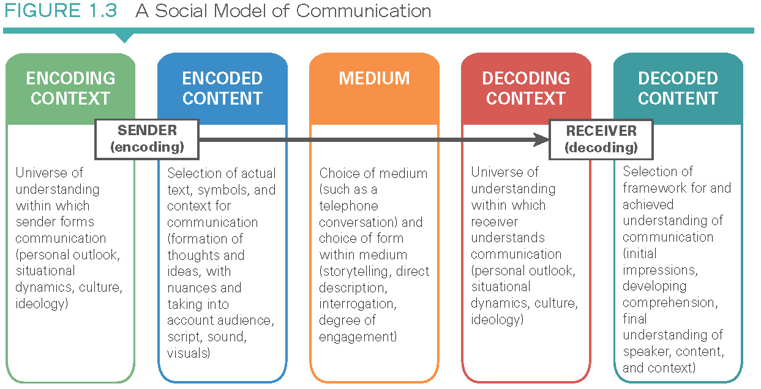
Models of Communication

Slide 26
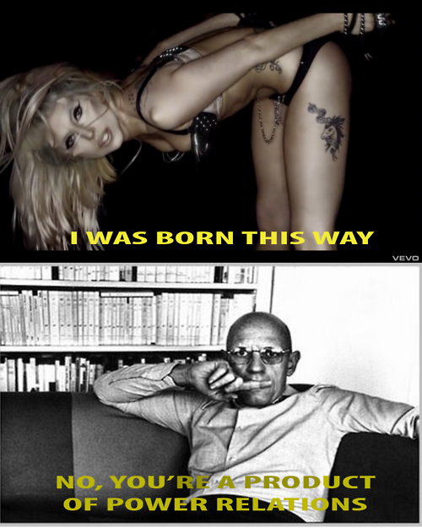
7 Media Literacy Concepts
All media are constructions
Audiences negotiate meaning in media
Media have commercial implications
Media contain ideological and value messages
Media have social and political implications
Form and content are closely related
Each media has unique aesthetic form

Slide 27

4 Components of Mass Media
1. Media messages – news items, novels, etc
2. Mass media – stuff that ‘carries’ messages (i.e. infrastructure – from cables to books)
3. Mass communication – process of how messages reach the audience on a large scale
Production and dissemination of mass information and entertainment
Decentralised production and wide accessibility
Interactive exchange
4. Mass audiences – diverse, unrelated in terms of nationality, gender, class, age, ‘tastes, etc
Notes:
27

Slide 28

The Dimensions of Mass Media
A distinct set of activities
Involving particular technological configurations
Associated with formally-constituted institutions and organizations
Acting within certain laws, rules, and understandings
Carried out by persons occupying certain roles: organizational dimensions of the media
Conveying information, entertainment, images, and words
To or among members of society: the mass audience?

